Slide 1
The NHS App
An overview for NHS staff
January 2024

Slide 2
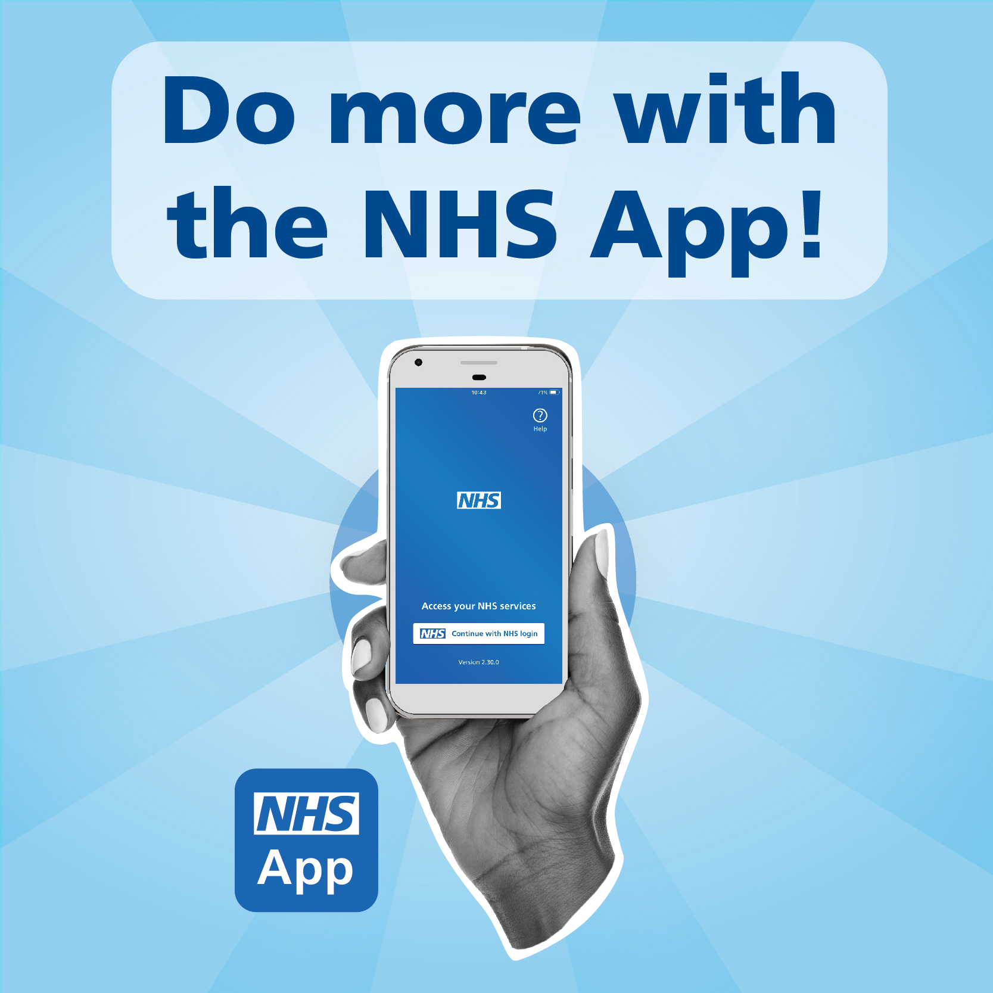
Contents
This pack includes:
an overview of the NHS App the services it offers
how the app can benefit your patients and the NHS
a promotional toolkit which you can use it to promote the NHS App in your area
guidance on tracking NHS App uptake in your area
how to get technical help and support
become an NHS App ambassador

Slide 3
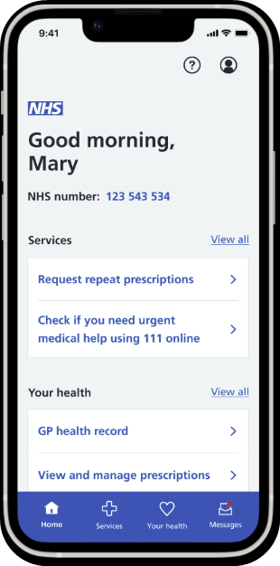
The NHS App
Helping people to stay well, get well and manage their health
Owned and run by the NHS, the NHS App enables people to access digital health and care services
It’s available to anyone 13 years and over, who is registered with an NHS GP practice in England or the Isle of Man
It's a safe and simple way to access a range of NHS services on your smartphone or tablet - anytime, anywhere.
All NHS App services can also be accessed online, through the NHS website.
New and improved
After extensive user testing, the NHS App has undergone a redesign to make it even more user friendly and easier to navigate.
The NHS App is constantly improving, find out what the team are working on next: Future developments for the NHS App - NHS Digital
Download the NHS App for yourself: https://www.nhs.uk/nhs-app/

Slide 4
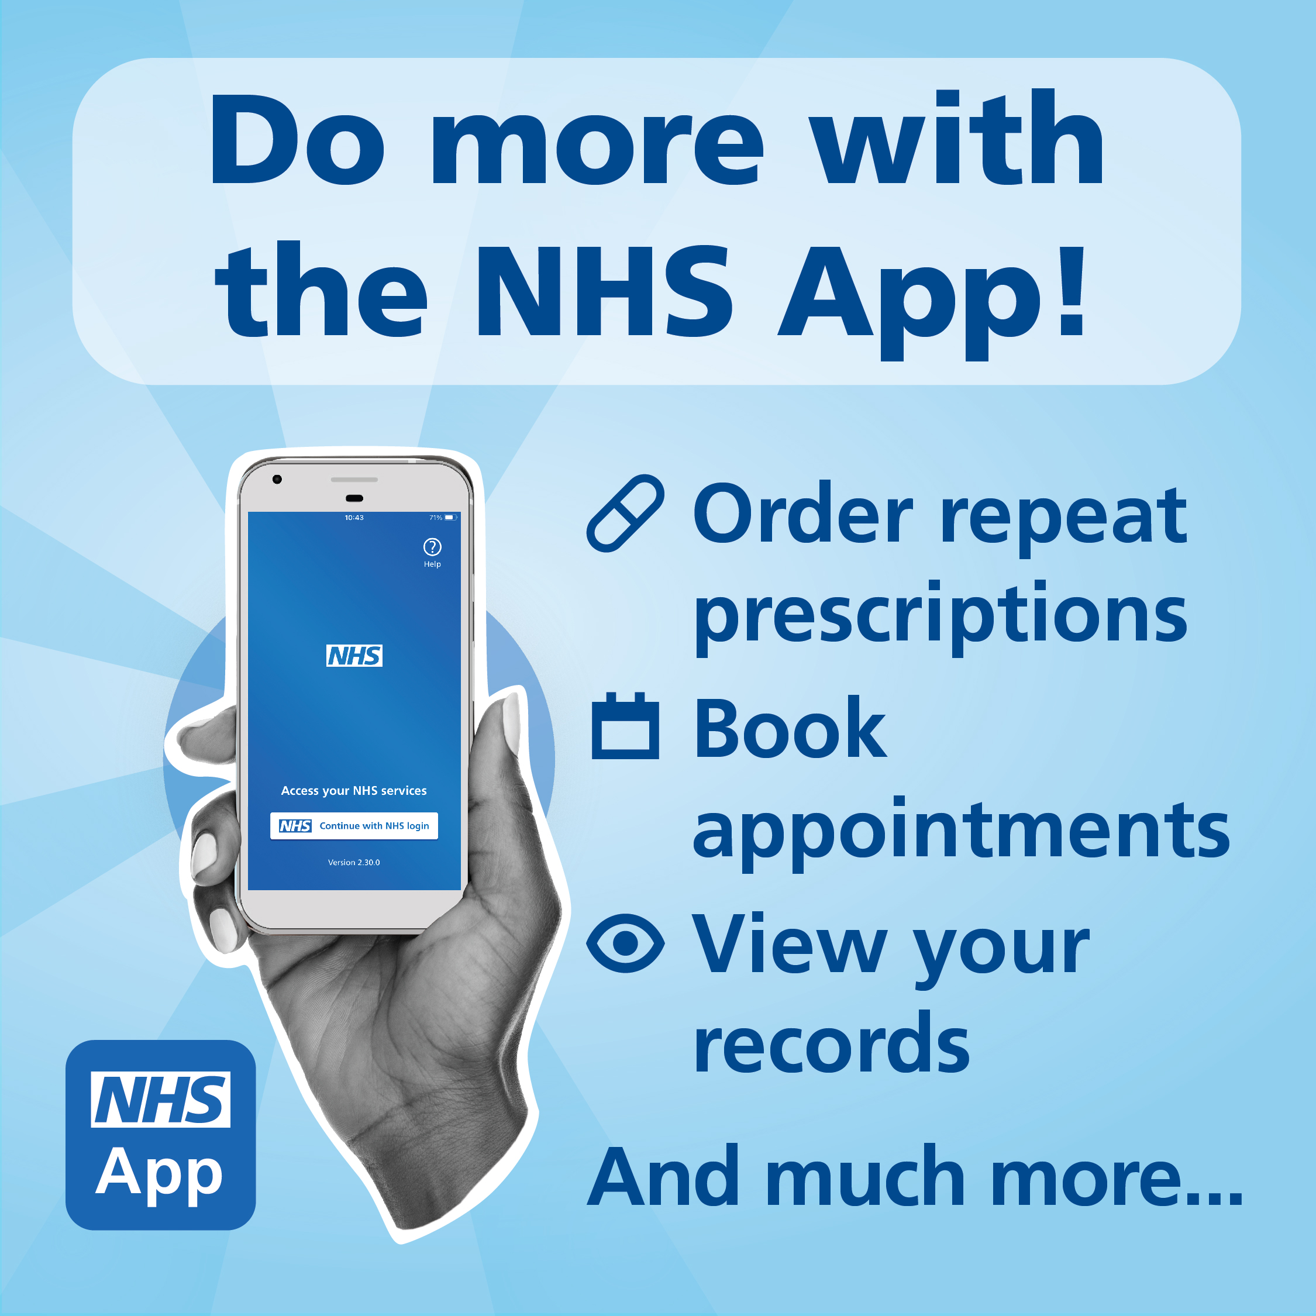
Why use the NHS App?
The NHS App helps you to*:
Get Well
Find NHS services near you
Use NHS 111 online
Book GP appointments
Manage your secondary care appointments
Contact your GP surgery using an online form
Stay Well
View your prescription details
Order repeat prescriptions and nominate a pharmacy
Book a COVID or Flu vaccine
Receive secure messages from your GP and healthcare providers
Search Health A-Z
Manage Your Health
View your health record
View test results
View your NHS number
Register for a GP online
Make an organ donation decision
Link accounts to help you manage the healthcare of someone you care for
Protect the NHS
It saves money by improving access to NHS services, lowering administrative and SMS messaging costs
It makes it easier for patients to digitally access services, helping patients receive the best care and supporting healthcare professionals to deliver it
*The features available to you depend on what has been enabled by your local area
Find out about enabling all NHS App features for your patients here: NHS App - NHS Digital

Slide 5
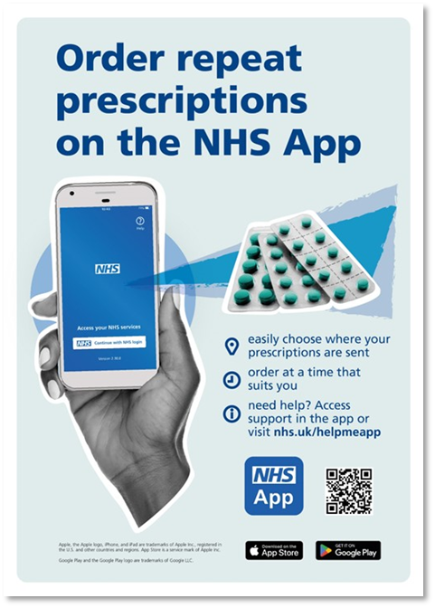
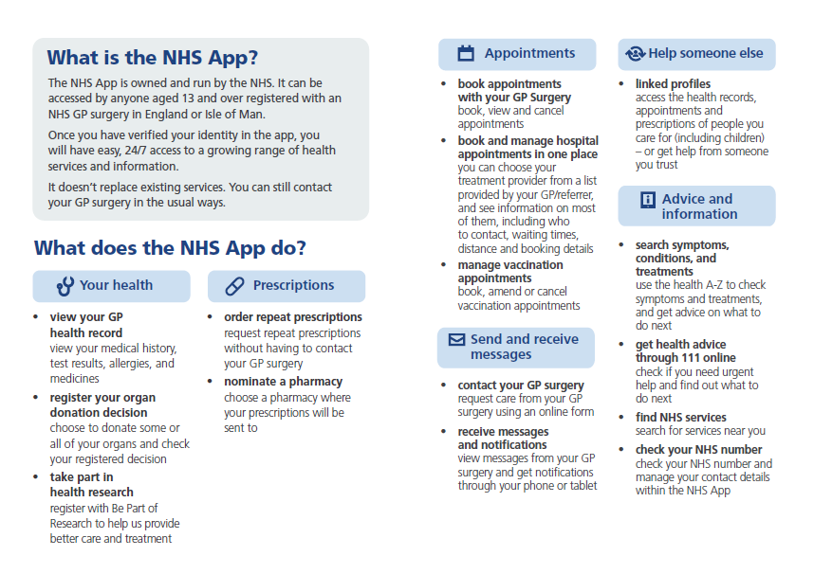
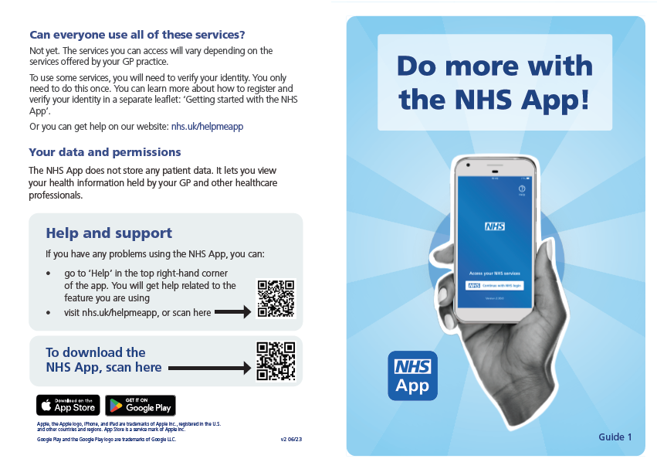
How you can promote the NHS App
The NHS App toolkit contains materials to help you spread the word how the NHS App benefits patients. Please share the toolkit with your colleagues and local comms team to promote the NHS App!
‘How to’ guidance leaflets
Designs can be printed in black and white
A4 promotional posters

Slide 6

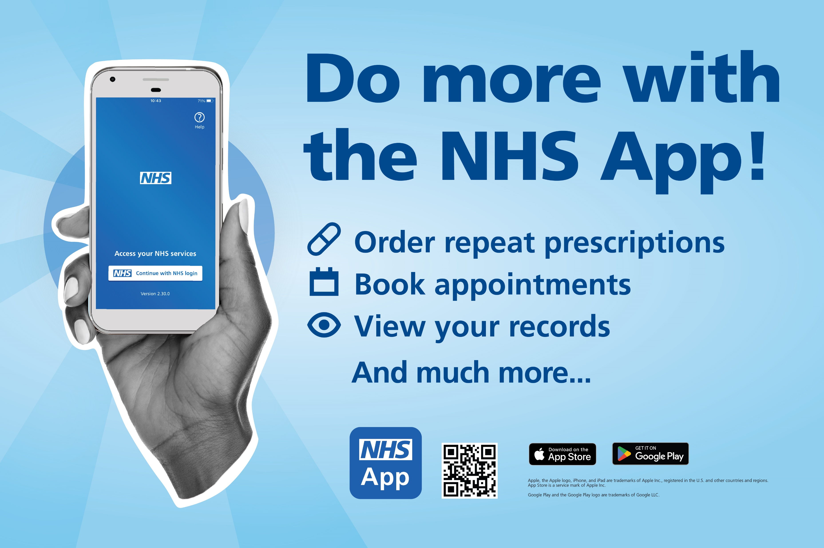
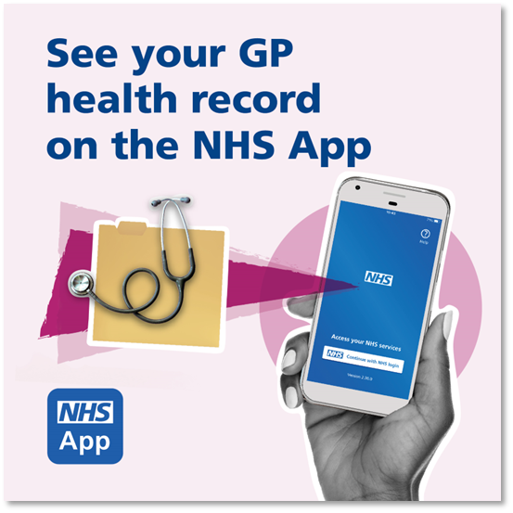
How you can promote the NHS App online
Banners for your website
It’s quick and easy to copy these images to your website and social media channels to promote app and its services:
The NHS App Toolkit
There are also key message templates to promote the app on websites, social media and through text (SMS) messages.
Images for your website and TV screens
Images for social media

Slide 7
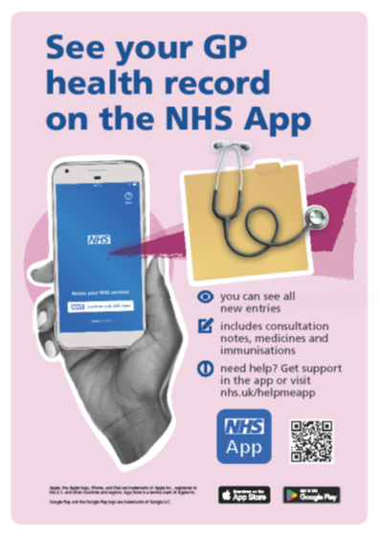
Supporting you to promote NHS App
Please share the toolkit with your colleagues and local comms team to promote the NHS App!
Other tools to help you promote the NHS App include:
an NHS App Dashboard to track app uptake and usage in your area - this can support decision making and give insight into how your promotion is making a difference.
setting up a test-patient to test the NHS App and demonstrate it to your patients - you need access to a clinical system to do this.

Slide 8
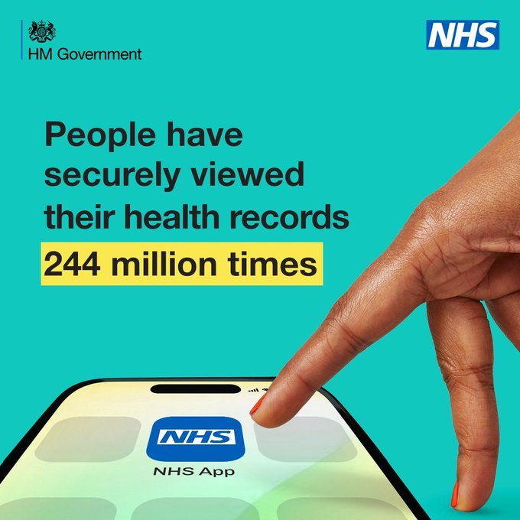
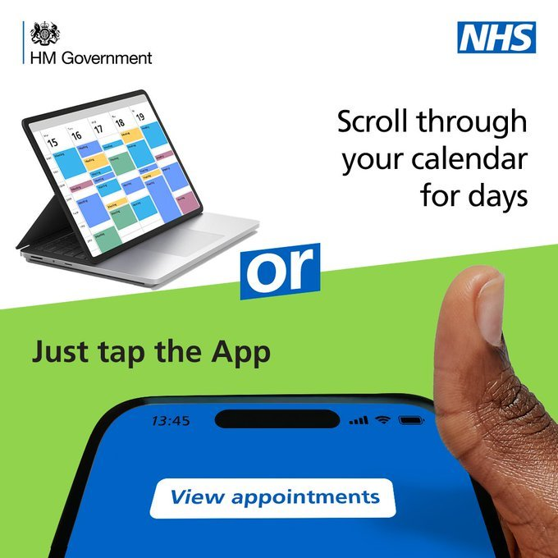
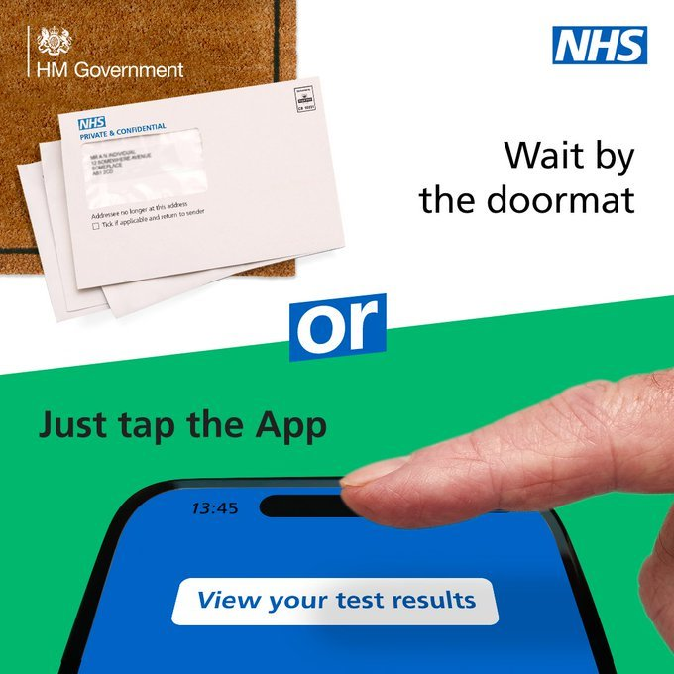
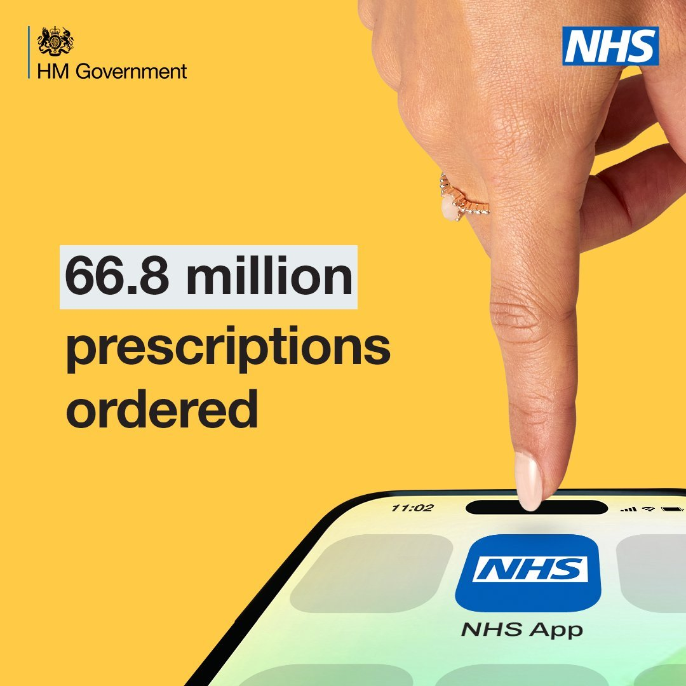
National Marketing Campaign
'Tap the App'
NHS England has launched a new campaign to encourage greater use of the NHS App. ​
It shows how to conveniently access essential health and care services you simply need to ‘tap the App’. ​
The materials are available to use and share from the Campaign Resource Centre: NHS App | Campaigns | Campaign Resource Centre (dhsc.gov.uk)

Slide 9
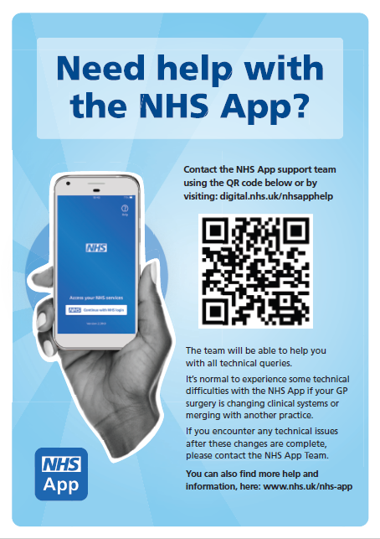
Technical Support and Guidance
For Patients:
NHS App help and support (www.nhs.uk) - This can also be accessed via the help button in the top right corner of the app.
If patients can’t find what they’re looking for, they can raise a ticket or you can raise one on their behalf:
Tell us what you need help with (www.nhs.uk)
For NHS staff:
Guidance, tips and useful links for GP practice: Using the NHS App: Guidance for GP practices - NHS Digital
Find further information for GP practices, acute trusts and ICBs here: NHS App - NHS Digital
If you need further assistance as a member of staff, please contact nhsapp@nhs.net.
Help poster: can be found here

Slide 10

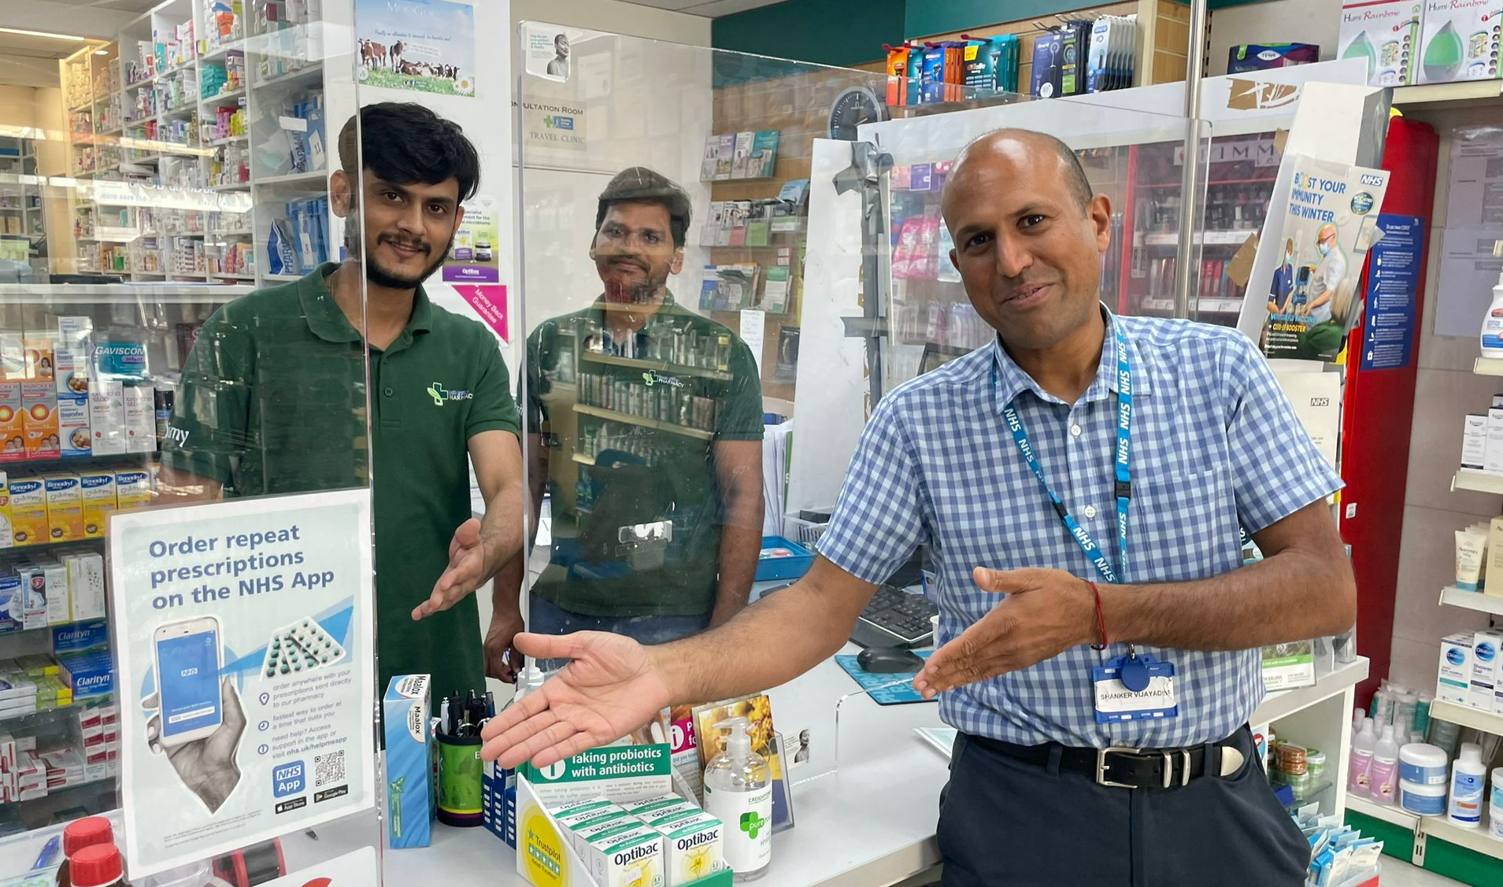

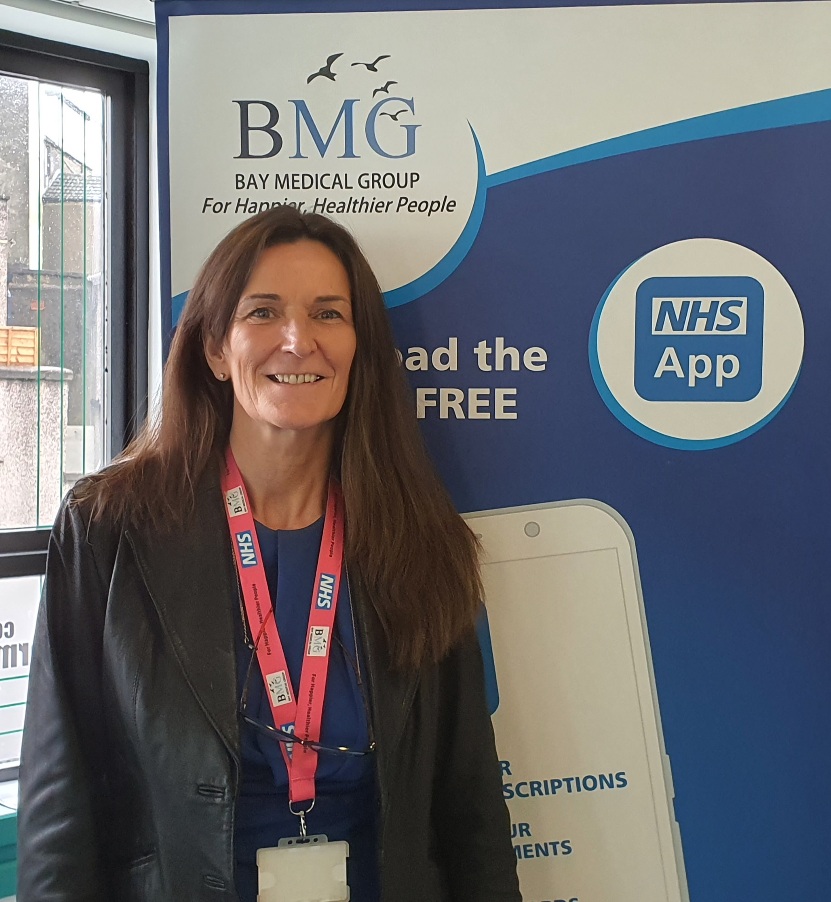
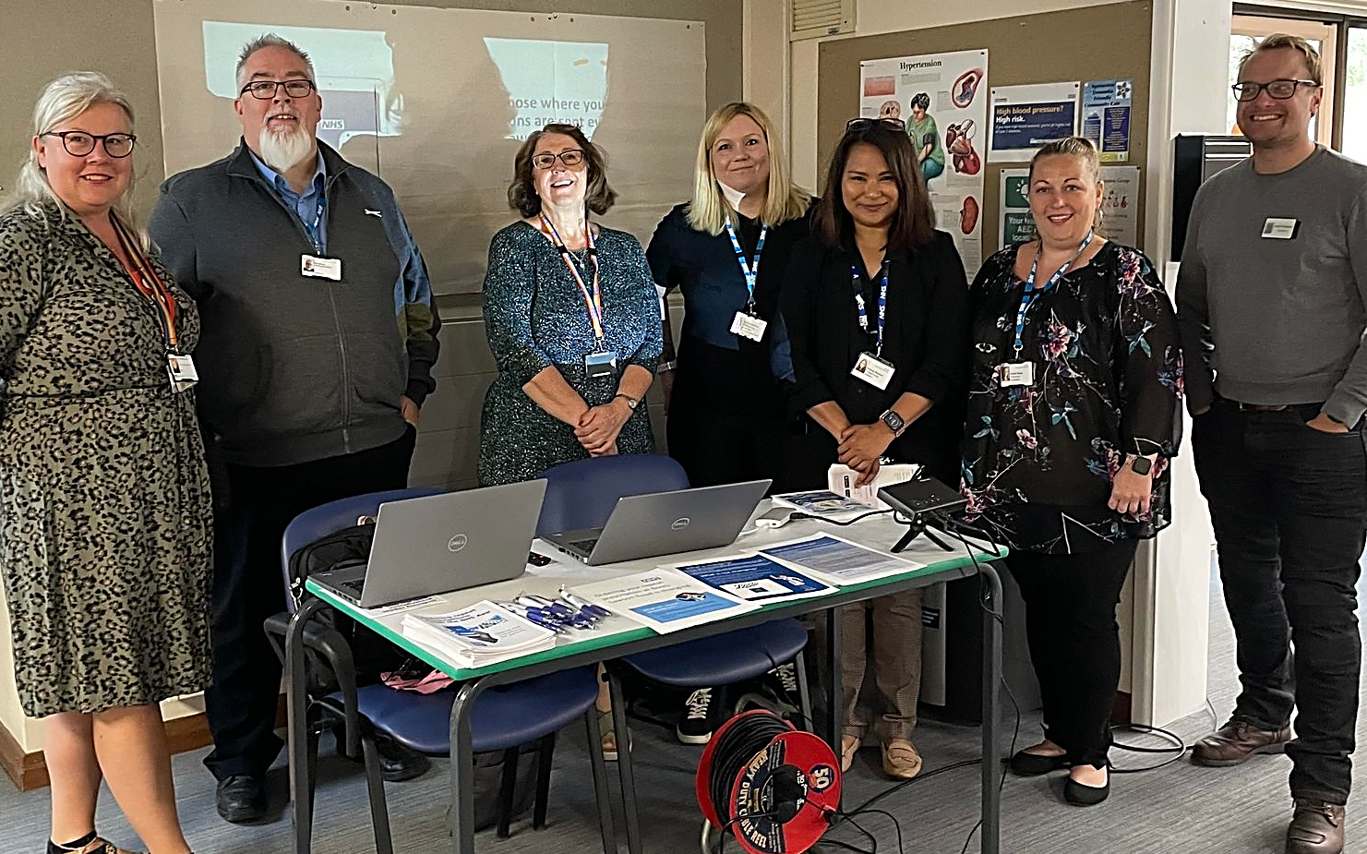
Become an NHS App Ambassador
NHS App ambassadors are vital advocates, spreading the word to colleagues and patients about the NHS App’s benefits through various activities. They work in many roles across the NHS.
Why become an NHS App Ambassador?
Stay informed with the latest app updates and campaign materials to share with your network
Join a community sharing best practice
Develop your leadership and persuasion skills in a flexible role that fits around your work
Attend webinars with the NHS App team and get your questions answers
Find out more: Become an NHS App ambassador
To join our community of people passionate about how technology can improve care, please contact appambassadors@nhs.net

