Slide 1
The NHS App
Helping people to stay well, get well and manage their health ​
January 2024

Slide 2
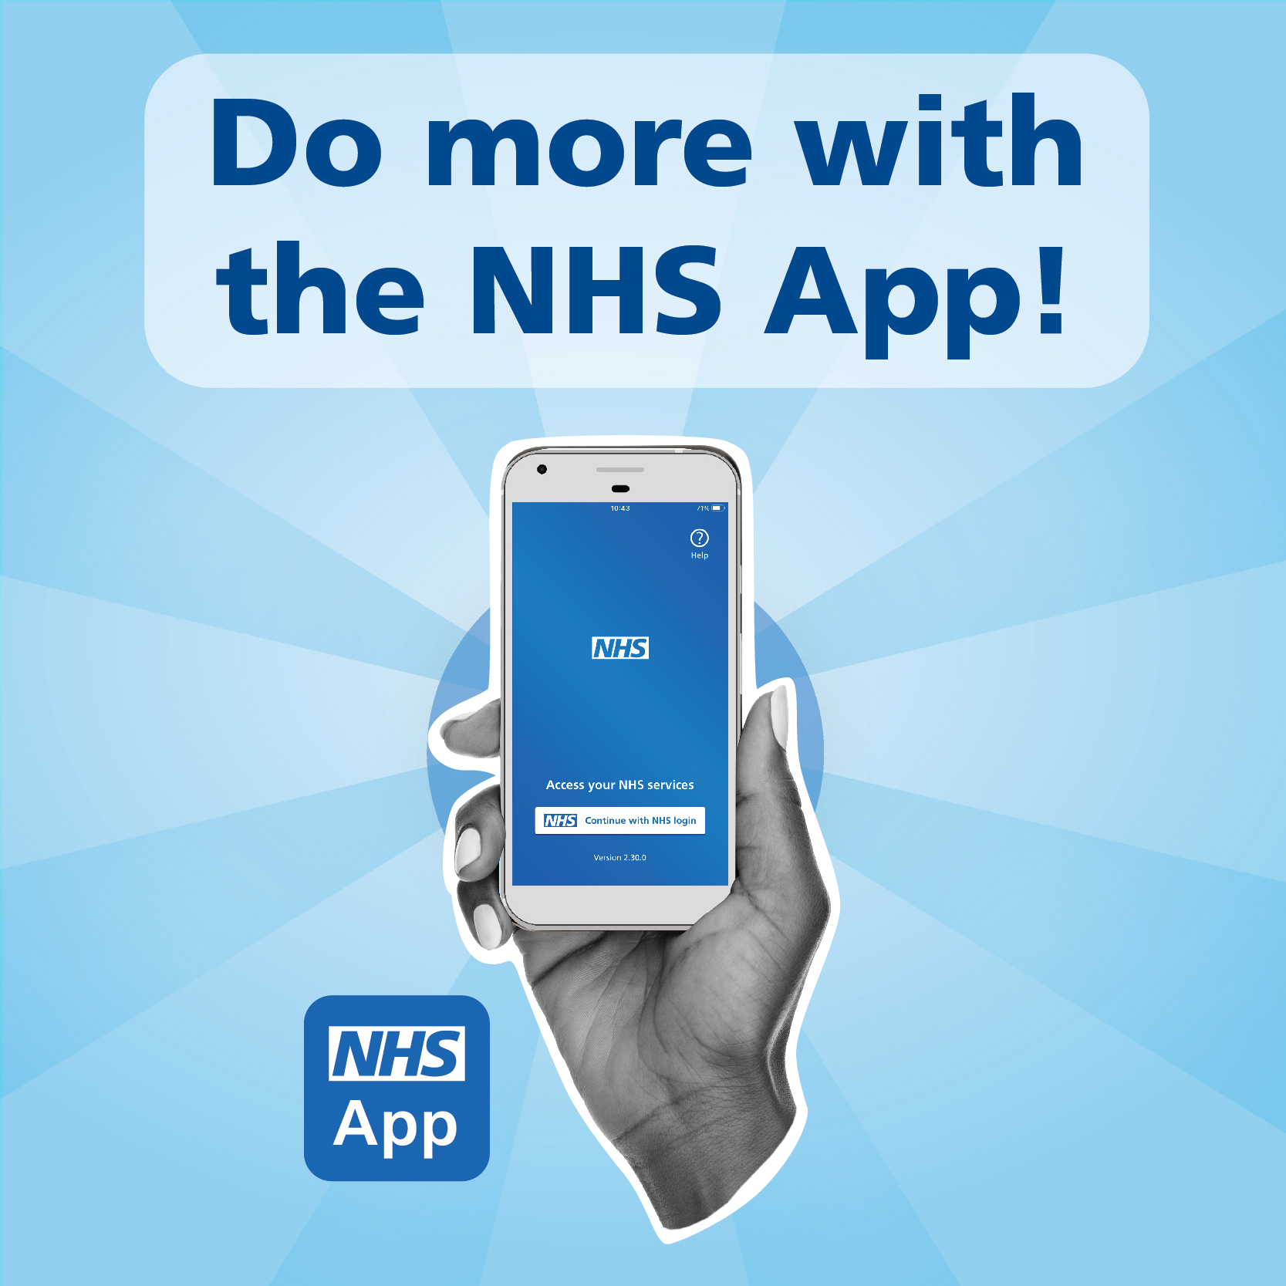
Contents
This pack includes:
an overview of the NHS App and the services it offers
the benefits of using the NHS App
a promotional toolkit which makes it easy to encourage others to use the NHS App
technical help and support for the NHS App
If you would like to potentially receive future updates about the NHS App, please sign up here: https://forms.office.com/e/Z2XDgksvXx

Slide 3
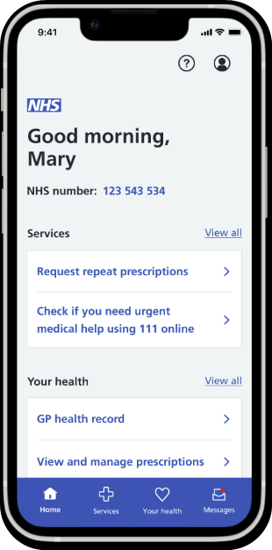
The NHS App
Owned and run by the NHS, the NHS App enables people to access digital health and care services
It’s available to anyone 13 years and over, who is registered with an NHS GP practice in England or the Isle of Man
It's a safe and simple way to access a range of NHS services on your smartphone or tablet - anytime, anywhere
All NHS App services can also be accessed online, through the NHS website
New and improved
After extensive user testing, the NHS App has undergone a recent redesign to make it even more user friendly and easier to navigate.
Download the NHS App for yourself: https://www.nhs.uk/nhs-app/

Slide 4
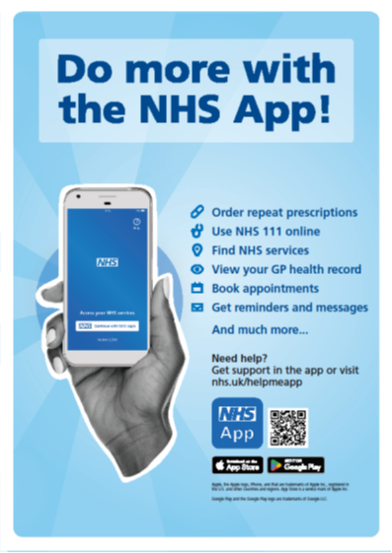
Why use the NHS App?
*The features available to you depend on what has been enabled by your local area
The NHS App helps you to*:
Get Well
Find NHS services near you
Use NHS 111 online
Book GP appointments
Manage your secondary care appointments
Contact your GP surgery using an online form
Stay Well
View your prescription details
Order repeat prescriptions and nominate a pharmacy
Book a COVID or Flu vaccine
Receive secure messages from your GP and healthcare providers
Search Health A-Z
Manage Your Health
View your health record
View test results
View your NHS number
Register for a GP online
Make an organ donation decision
Link accounts to help manage the health care of someone you care for
Protect the NHS
It saves money by improving access to NHS services, lowering administrative and SMS messaging costs
It makes it easier for patients to digitally access services, helping patients receive the best care and supporting healthcare professionals to deliver it

Slide 5
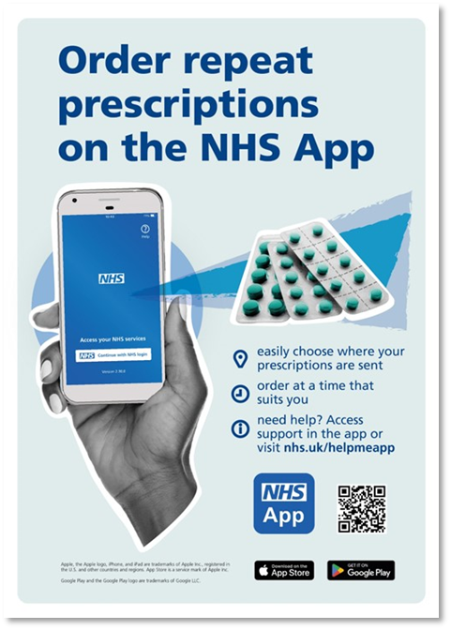
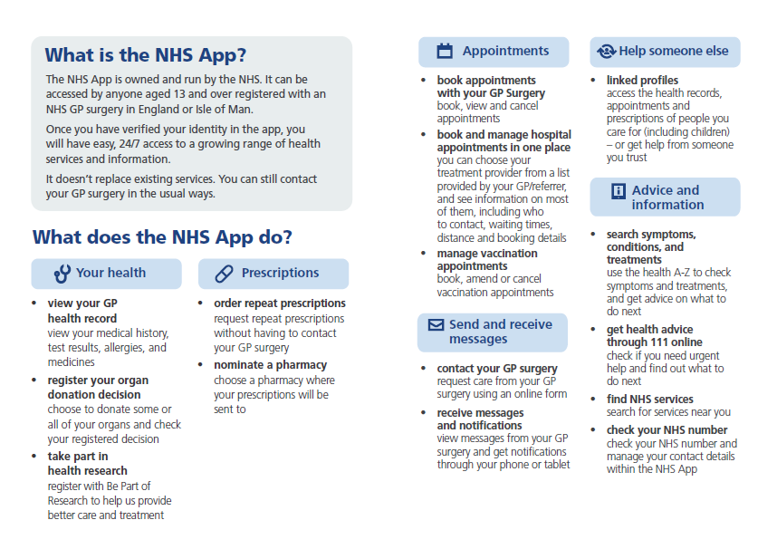
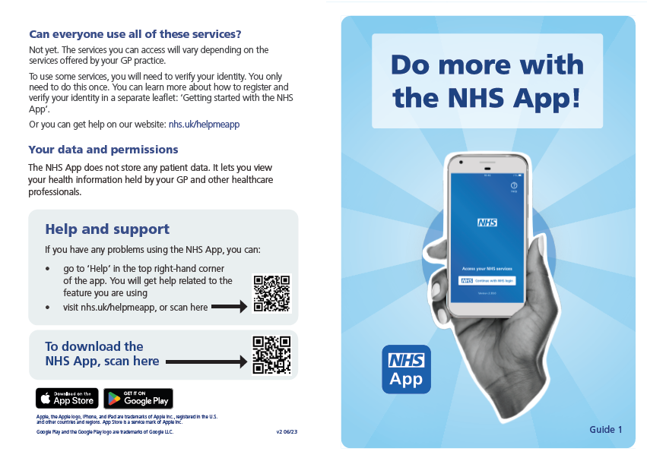
How you can promote the NHS App
The NHS App toolkit contains materials to help you to spread the word about what the NHS App can do in your area.
‘How to’ guidance leaflets
Designs can be printed in black and white
A4 promotional posters

Slide 6

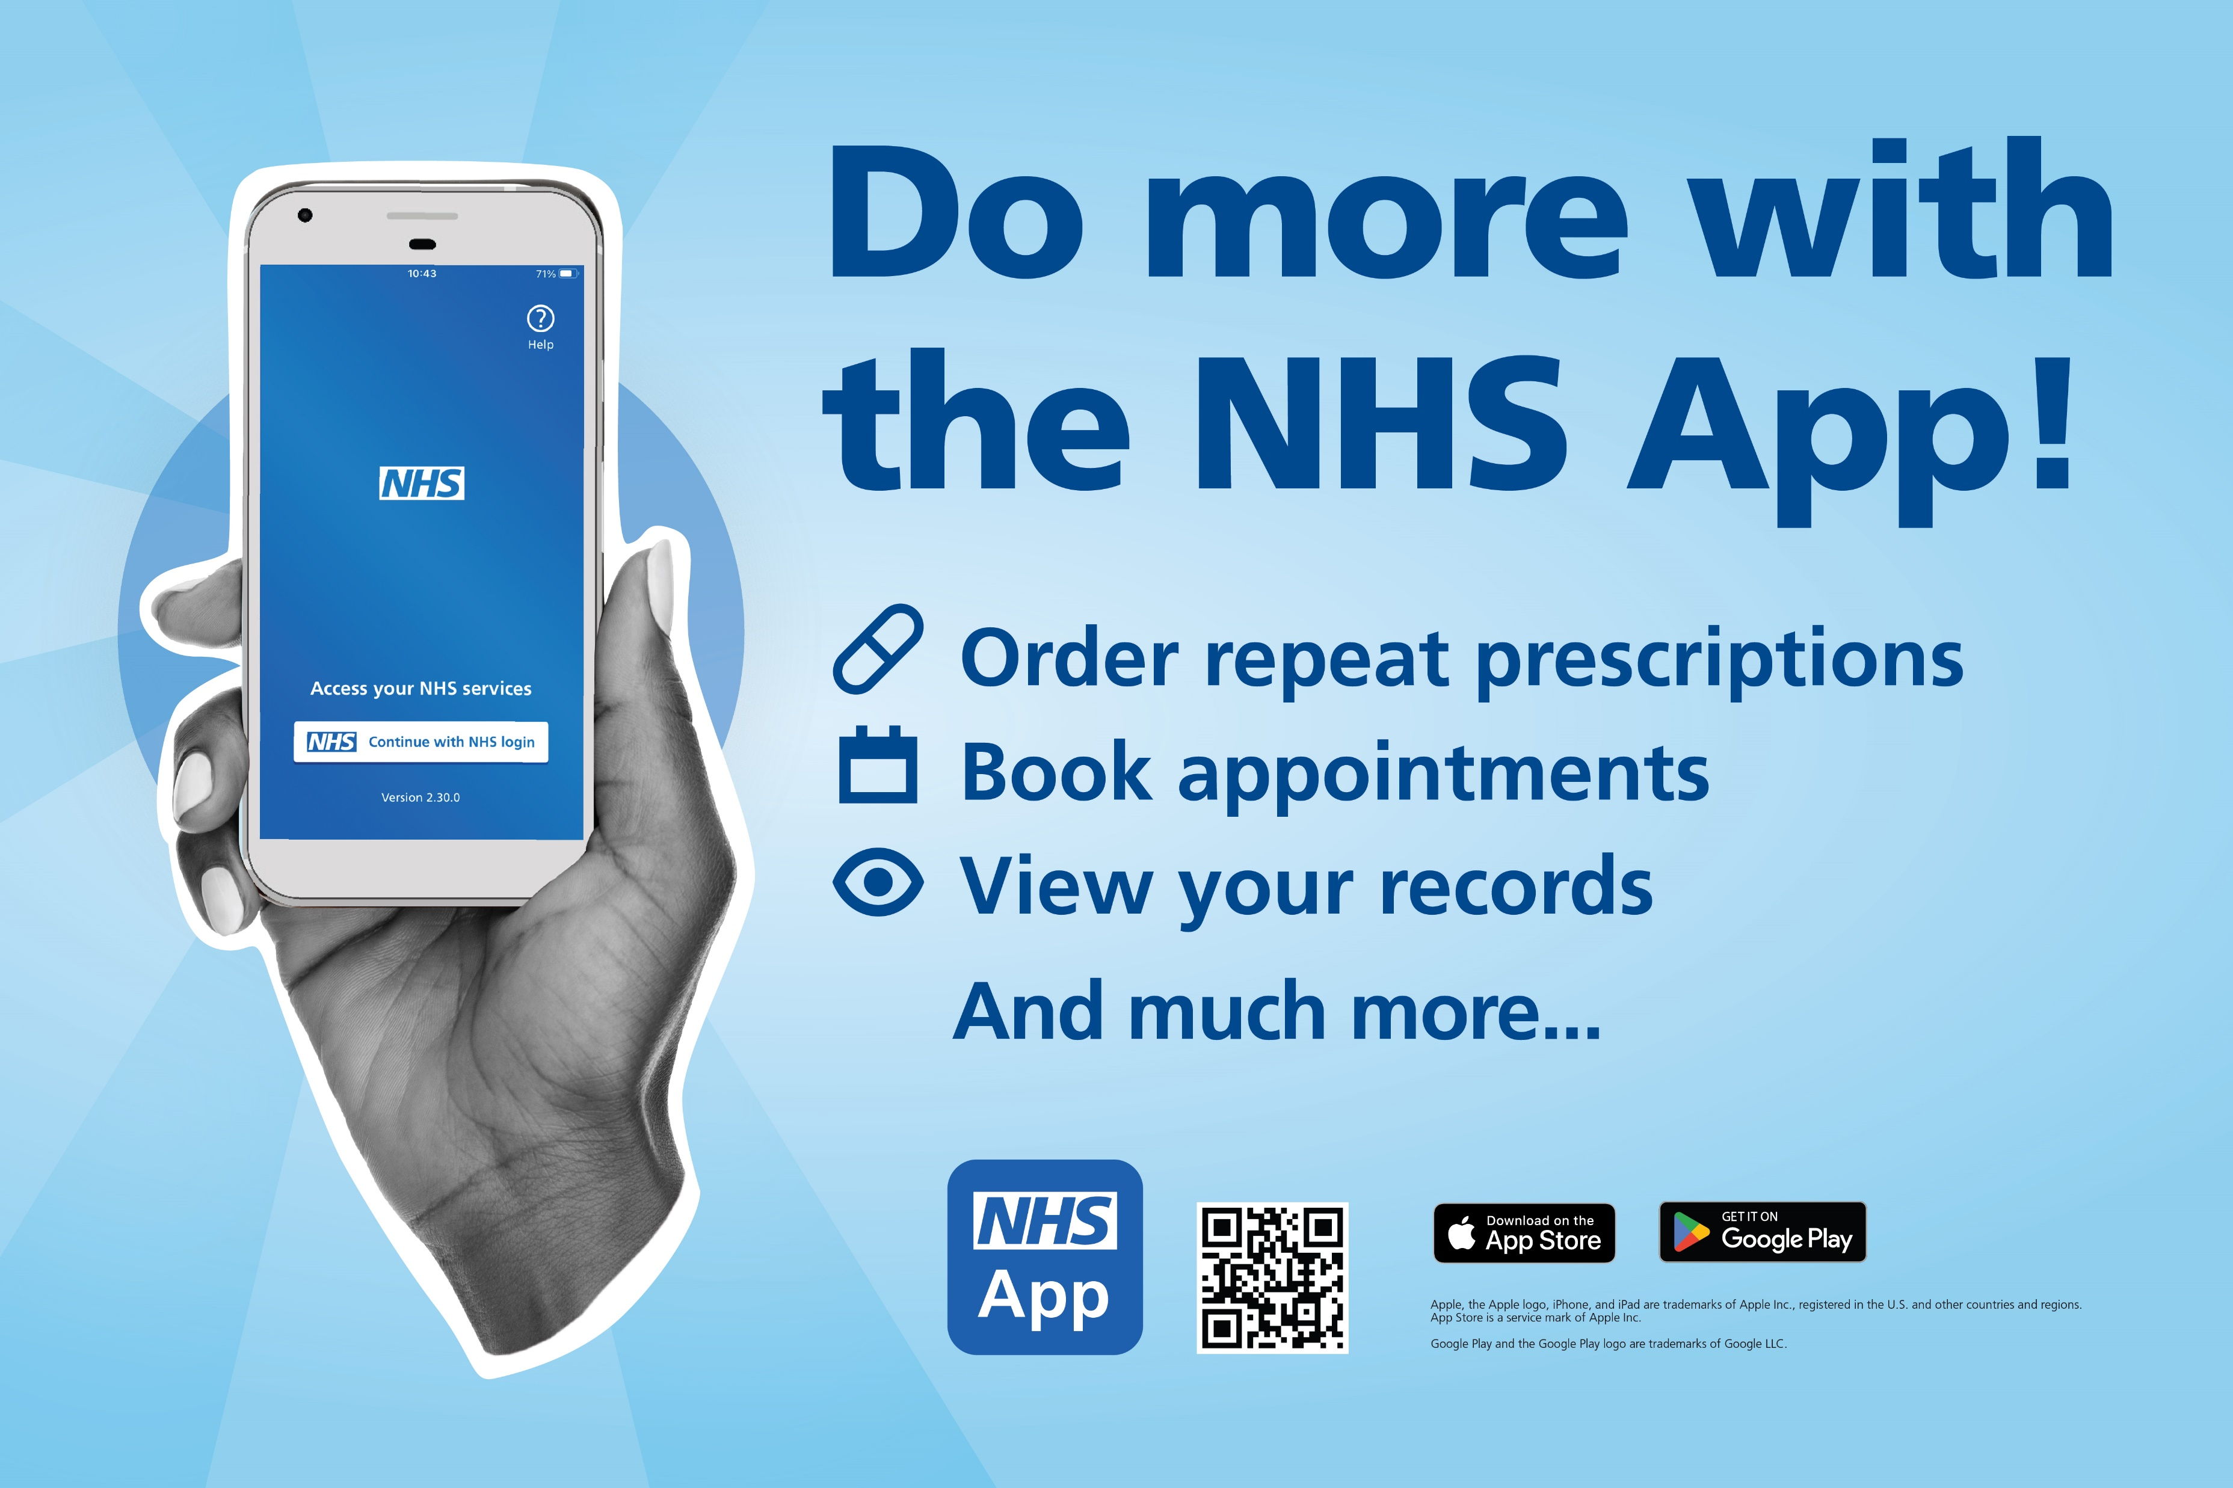
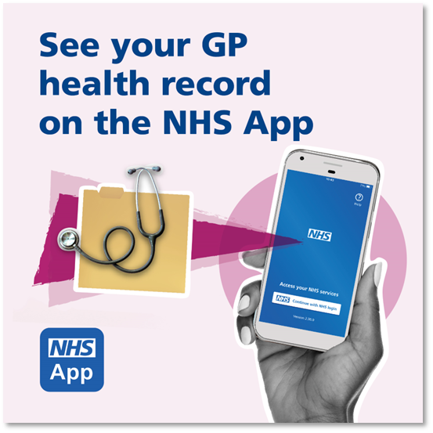
How you can promote the NHS App online
Banners for your website
It’s quick and easy to copy these images to your website and your personal/organisation’s
social media channels to promote the NHS App and the services it offers:
The NHS App Toolkit
Images for your website and TV screens
Images for social media

Slide 7
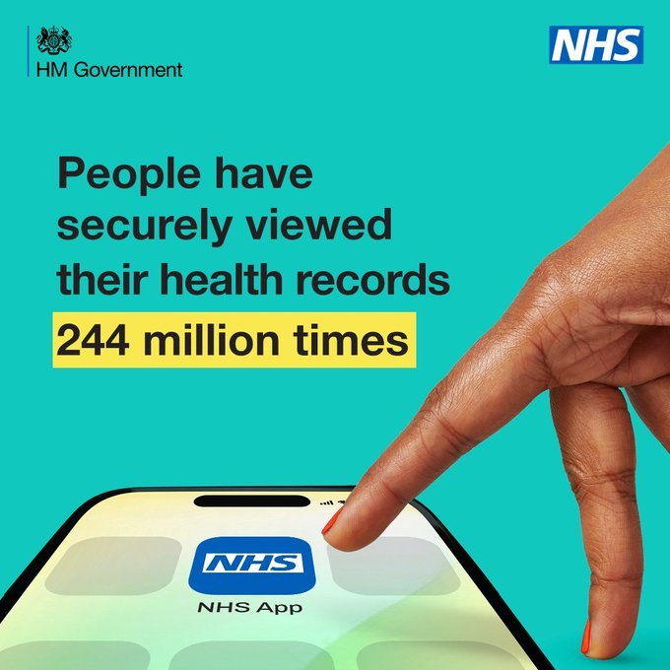
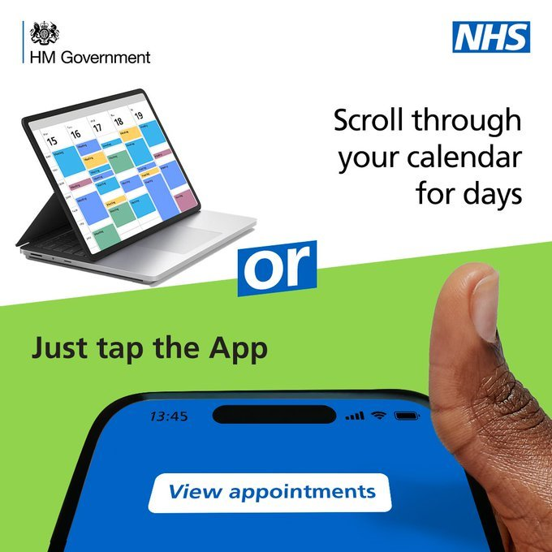
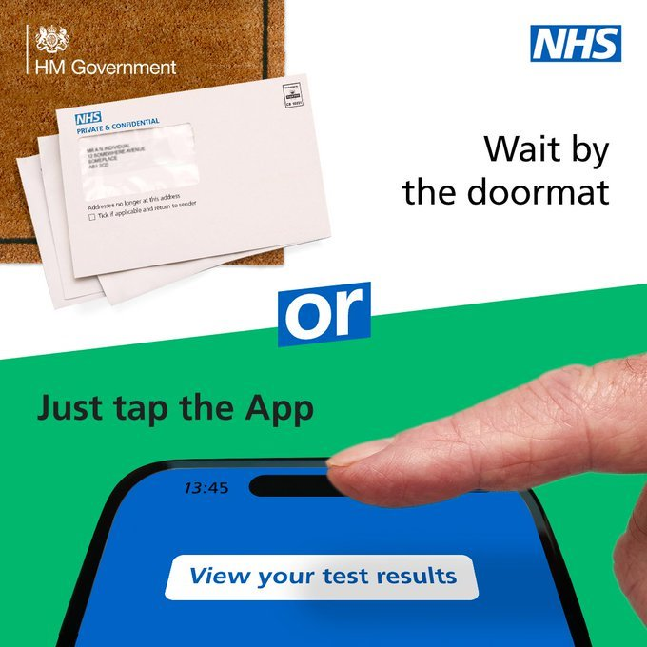
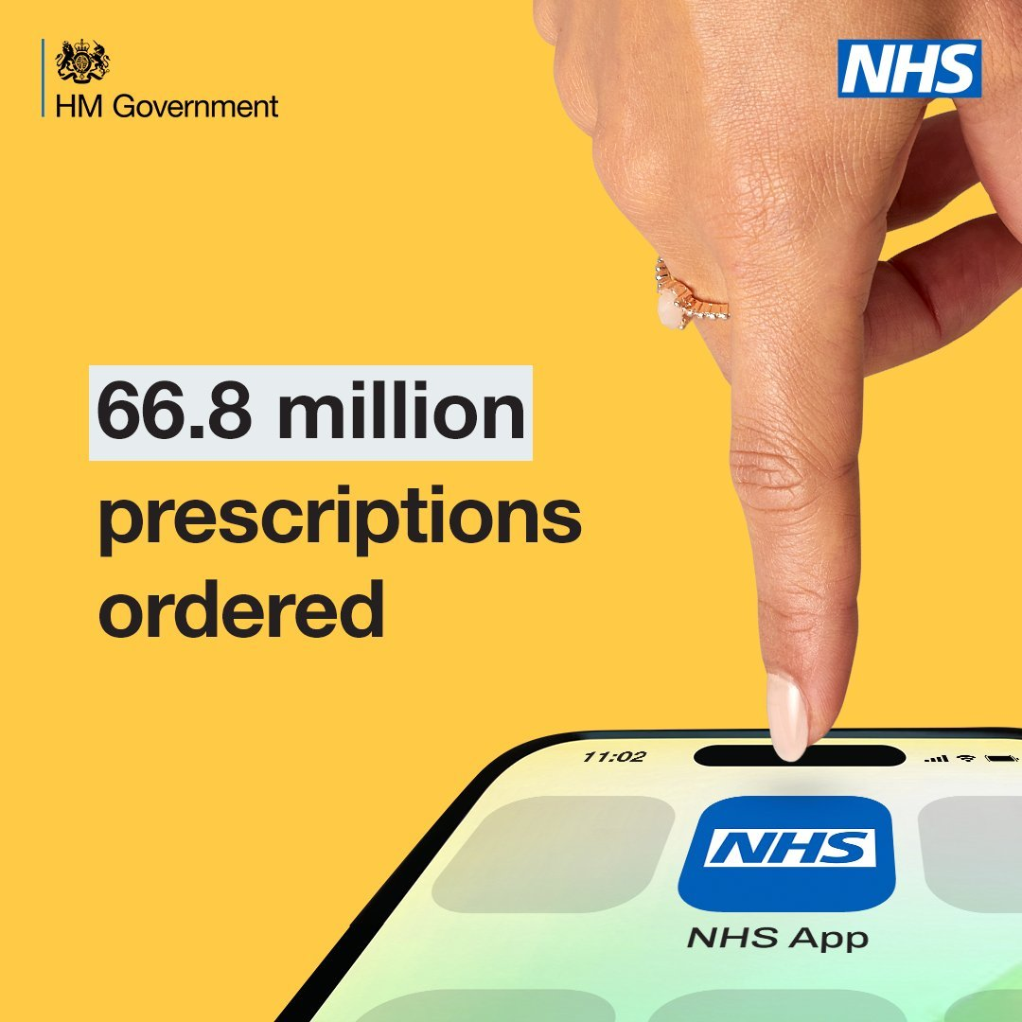
National Marketing Campaign
'Tap the App'
NHS England has launched a new campaign to encourage greater use of the NHS App. ​
It shows how to conveniently access essential health and care services you simply need to ‘tap the App’. ​
The materials are available to use and share from the Campaign Resource Centre: NHS App | Campaigns | Campaign Resource Centre (dhsc.gov.uk)

Slide 8
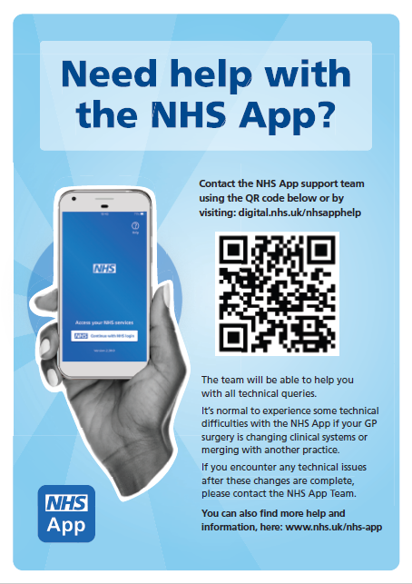
Technical Support and Guidance
NHS App help and support can be found here:
NHS App help and support - NHS (www.nhs.uk)
- This can also be accessed via the help button in the top right corner of the app.
If you can’t find what you’re looking for, you can raise a ticket to the NHS App team here:
Tell us what you need help with (www.nhs.uk)
Help poster: can be found here

