Slide 1
Lung Cancer Screening:
Quality Assurance Support for Cancer Alliances
NHS England Lung Cancer Screening Team
23rd June 2026
Notes:
Standard title slide

Slide 2
House-keeping
We’re going to record the presentations so that we can share after the session.
You’re welcome to add questions in the chat as we go and we’ll come back to them.
Notes:
Put the recording on!! Please be aware if you ask questions during the recording you are being recorded!

Slide 3
Agenda
Overarching plan for quality assurance of the LCSDS – Sam
Tracking submission progress:
National Data Submission Portal monitoring tools - Sarah
Quality assurance dashboard - Alex
Next steps
Q&A

Slide 4
Overarching plan for quality assurance and monitoring of the LCSDS

Slide 5
Analytical Reporting Requirements
March 2026
July 2026
Jan 2027
April 2027
2026
2027
Governance, access and readiness
Data development and derivations
Data quality, rules and assurance
National dashboard development
Data linkage
Cancer Alliance record level access
Notes:
Main focus for 2026 financial year
Complete governance, access and readiness work for providers to be able to submit record level data
Complete data model development and derivations work to pipeline the dataset into FDP for analytical and quality assurance reporting
Define the data quality rules and assurances – develop a data quality dashboard for national team and cancer alliances to access to monitor accuracy of data submitted and work with providers to improve this
Start development of national dashboard reporting activity data for the programme. This won’t be used as the main source of reporting for 2026=27 financial year as aggregate data will continue to be submitted and used – we also won’t have the ability to link the data as we continue to develop this work. But the hope is that we can demonstrate usability of this
Main focus for 27/28 year
Data linkage complete
Access to record level data for cancer alliances
Monthly dashboard replacing cancer alliance data packs

Slide 6
Analytical Reporting Requirements
March 2026
July 2026
Jan 2027
April 2027
2026
2027
Governance, access and readiness
Real Time (NDSP – Sarah)
Providers: data quality report detailing file and record level rejections
Cancer Alliances: view on which providers have submitted, how many resubmissions, and highlight data quality information (e.g. % records rejected)
Monthly Dashboard to summarise quality position (FDP – Alex)
(to be developed July 2026 onwards, expectation to be live from January 2027 onwards)
Ability for Cancer Alliances and the national team to sense check the data, reviewing aggregate summations for errors. E.g. any missing data for key data items (invites, lung health checks, scans).
Data development and derivations
Data quality, rules and assurance
National dashboard development
Data linkage
Cancer Alliance record level access

Slide 7
Tracking submission progress:
National Data Submission Portal monitoring tools
Notes:
Introduce self, NDSP team
Last year’s CA workshops lo

Slide 8
Tracking submission progress
Last autumn, lots of you attended workshops for Cancer Alliances to discuss moving from aggregate to patient level data collection, and the move away from CA directly submitting data.
You told us that you need real-time understanding of data submissions within your area, so that:
  You have assurance that data is being submitted, and
  Visibility of any delays or issues so that you can support providers.
Today we’re going to look at the monitoring tools available to help with this.

Slide 9
National Data Submission Portal (NDSP)
Will be used by LCS submitters to send data in to NHS England.
Also offers monitoring tools for people with collection management responsibilities.
We’ll be making these monitoring tools available to Cancer Alliance staff.
Today:
  Introduction to NDSP
  Overview of data submission
  Monitoring tools walk through
  Next steps

Slide 10

What is the National Data Submission Portal (NDSP)?
A single data submission portal that sits on the National Data Integration Tenant (NDIT) platform
Choice of submission routes
  File upload
  API
  Webform
  FDP Local Tenant
Consistent submission & data validation
Collection management & monitoring
Notes:
NDSP will sit on NDIT
A single data submission portal
Manage everything in one place
Ambition is to eventually consolidate 24+ legacy portals
Choice of submission routes to reduce burden
API, file transfer, file upload, webform and FDP local tenant flows
Consistent data validation
Data Validation Engine (DVE) using shared rules
Collection management
Management information, collection windows, permissions

Slide 11
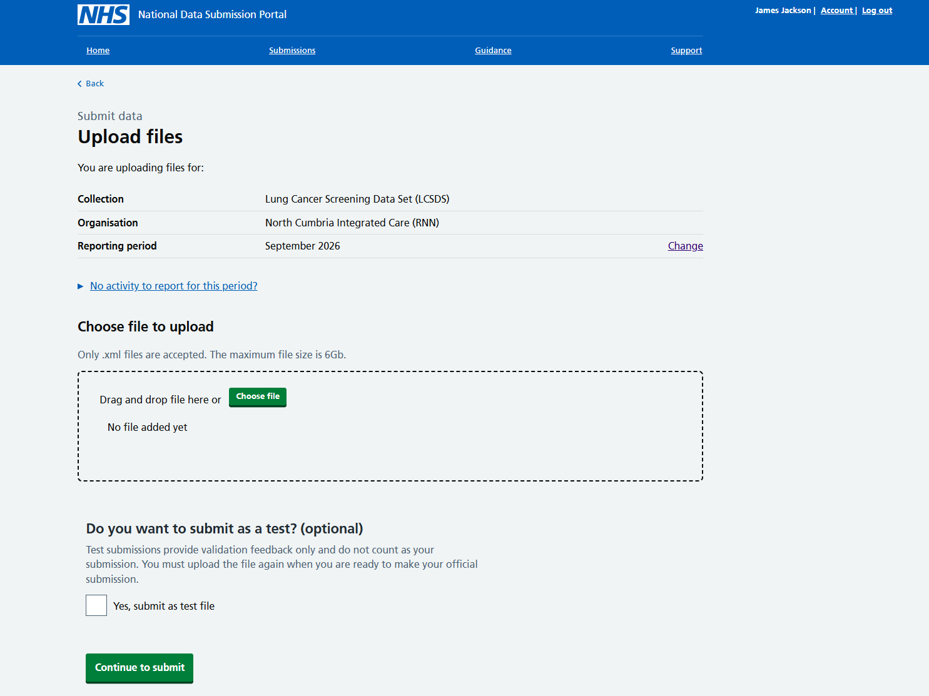
How will data submitters use NDSP to submit LCS records?
Data submitters will be able to upload LCS files via a web interface or an API.
The files are checked against a set of validation rules, and the submitter will get detailed feedback to allow them to address any errors against the ETOS.
Registered submitters will get reminders about collection windows opening, and when they are due to close.
We recently carried out some user research with LCS submitters to get feedback on the web submission journey: participants found the workflow straight forward and were able to submit dummy data files.
Notes:
We’ve

Slide 12
NDSP Submission monitoring
Enabling Cancer Alliances to track file submissions from the data submitters in your locality.
You’ll be able to view:
Progress for each submission window: how much data has been submitted.
An overview of submissions made by each submitting organisation in your area.
Summaries of submission issues, and which organisations are having problems.
You won't be able to see:
Information about submissions outside of your cancer alliance.
Patient identifiable data
Notes:
We are adapting monitoring tools developed for NHS England staff to give Cancer Alliances visibility of data submissions in your area.

Slide 13
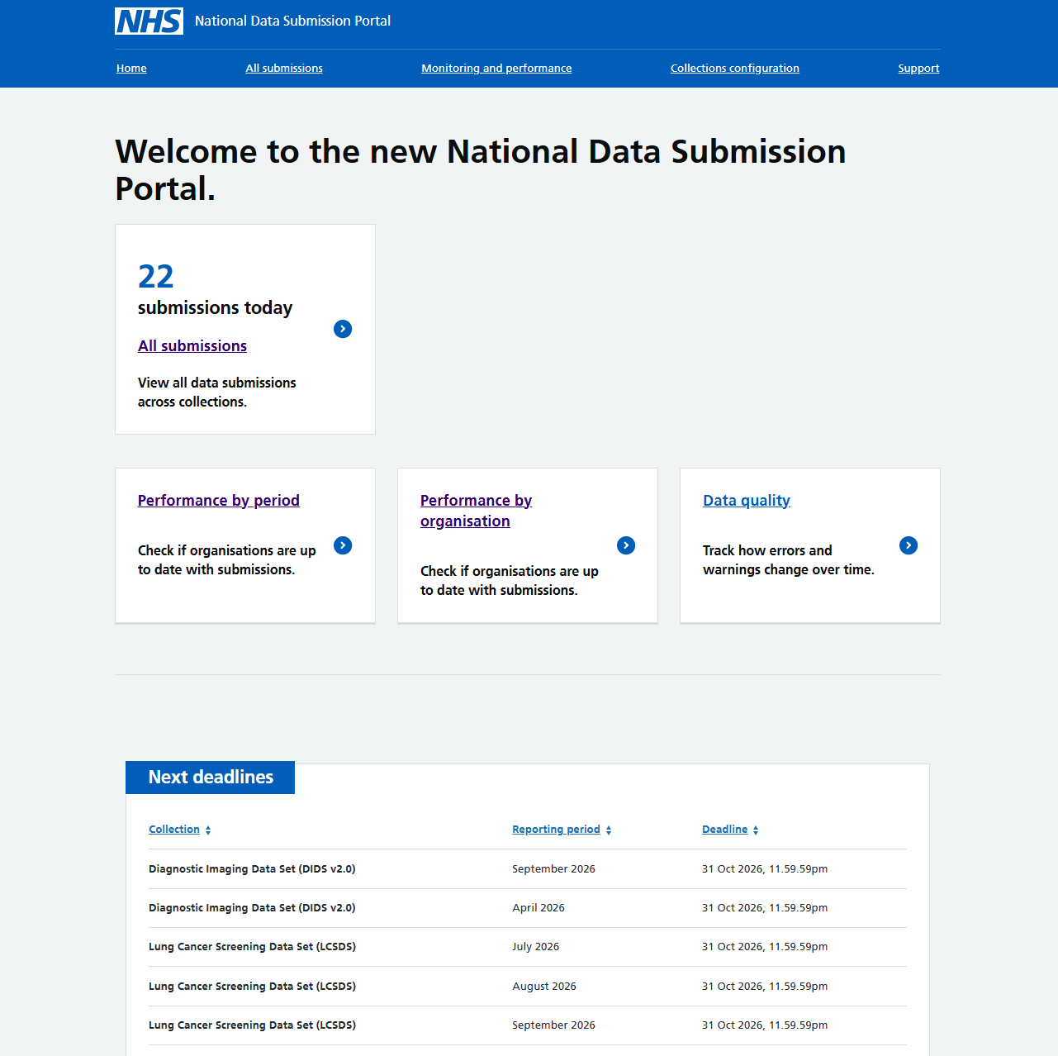
LCS monitoring: home page
Please note – all the data in this and all the screenshots is dummy data!

Slide 14
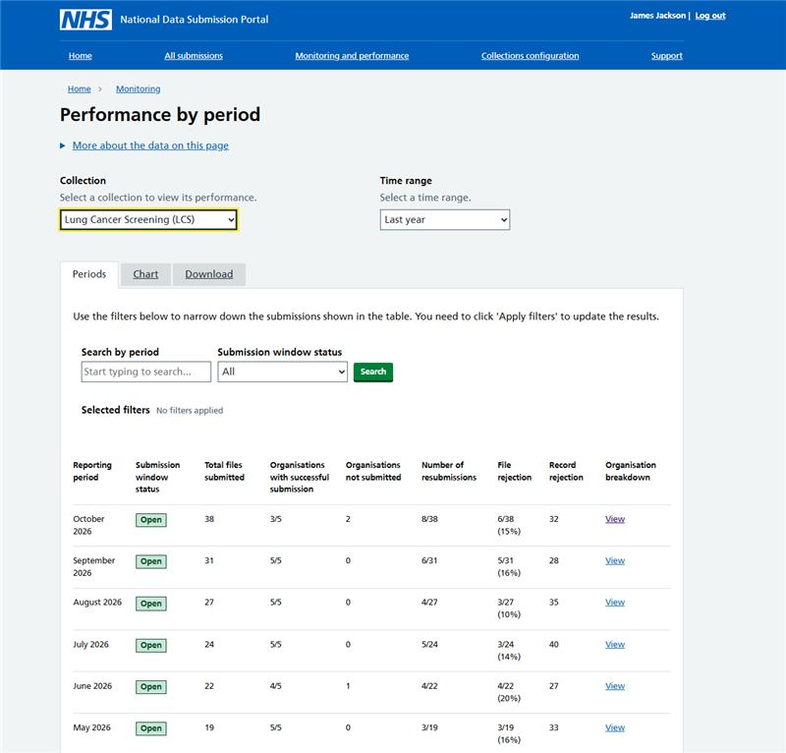
Performance by reporting period
Review how many files have been submitted for a reporting period.
Clicking on one of the ‘view’ links takes you to a more detailed view of a submission window.

Slide 15
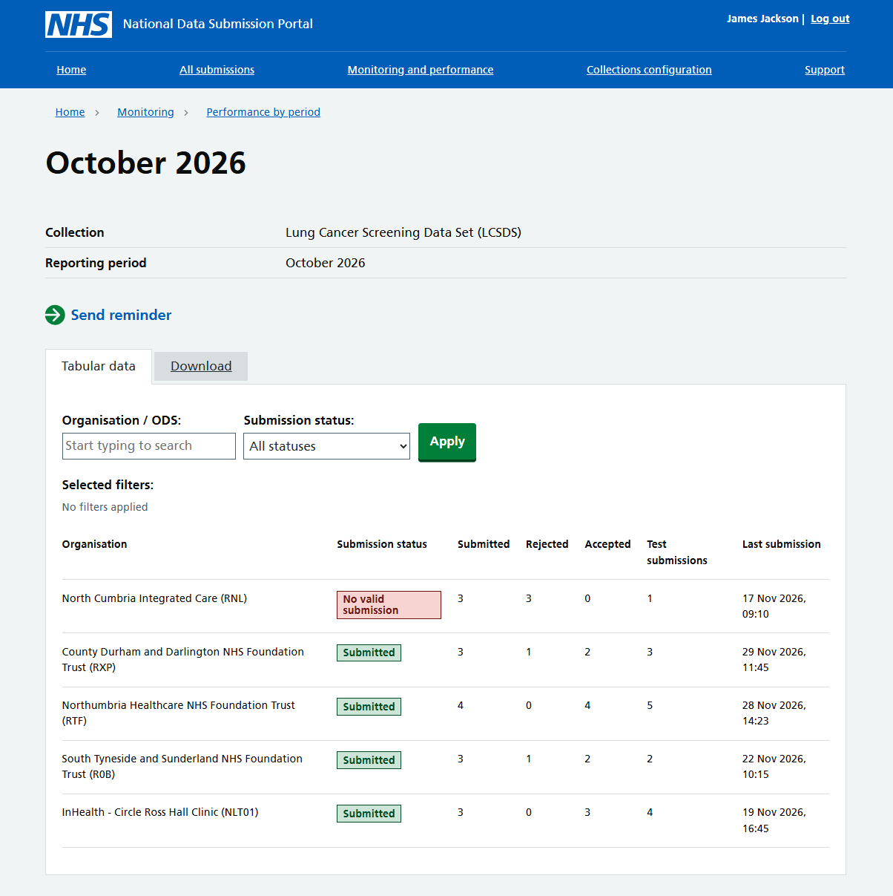
Reporting period – see more detail..
View more details on how each organisation is progressing with their submissions within the October 2026 reporting period.
Clicking on one of the ‘view’ links in the table takes you to a more detailed view of the organisation’s progress.

Slide 16
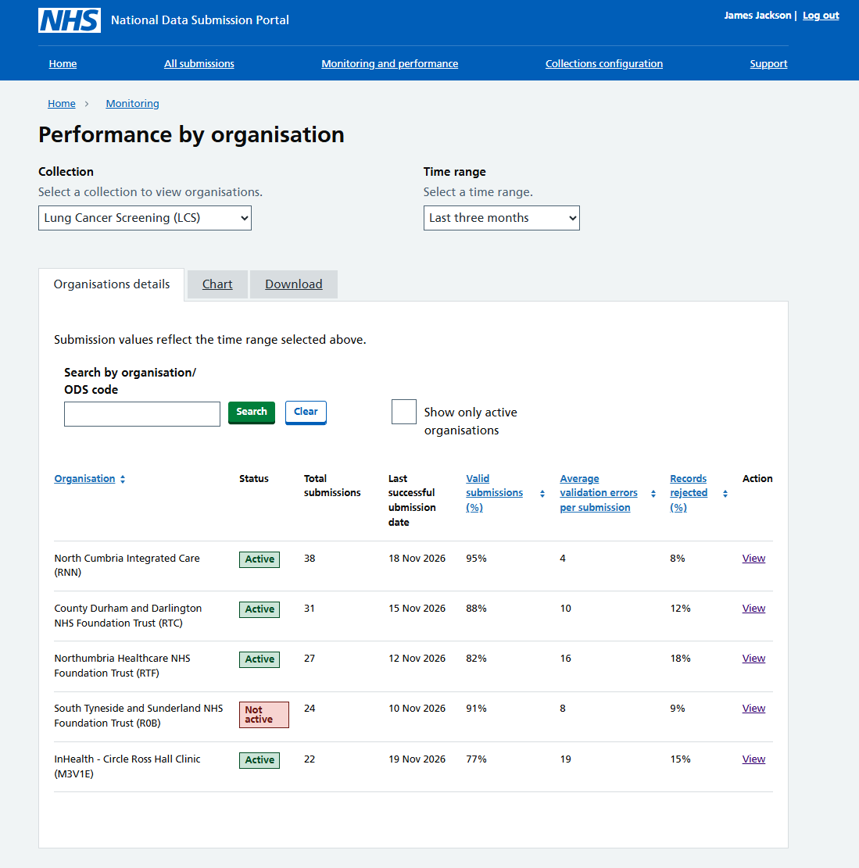
Performance by organisation
This gives you a view of which organisations within your cancer alliance are submitting data, and gives an overview of all their submissions.

Slide 17
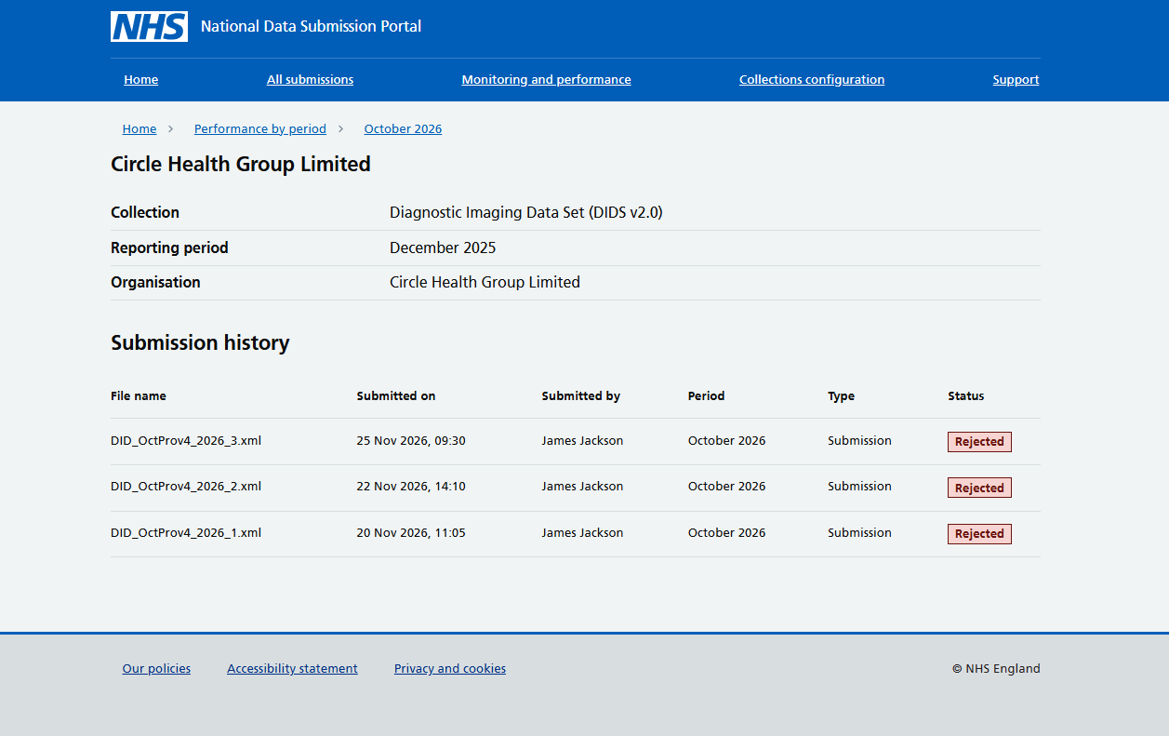
Reporting period – organisation progress details
Here, you can view more details on how each organisation is progressing with their submissions.
The table includes a summary of each attempted submission, and the outcome.

Slide 18
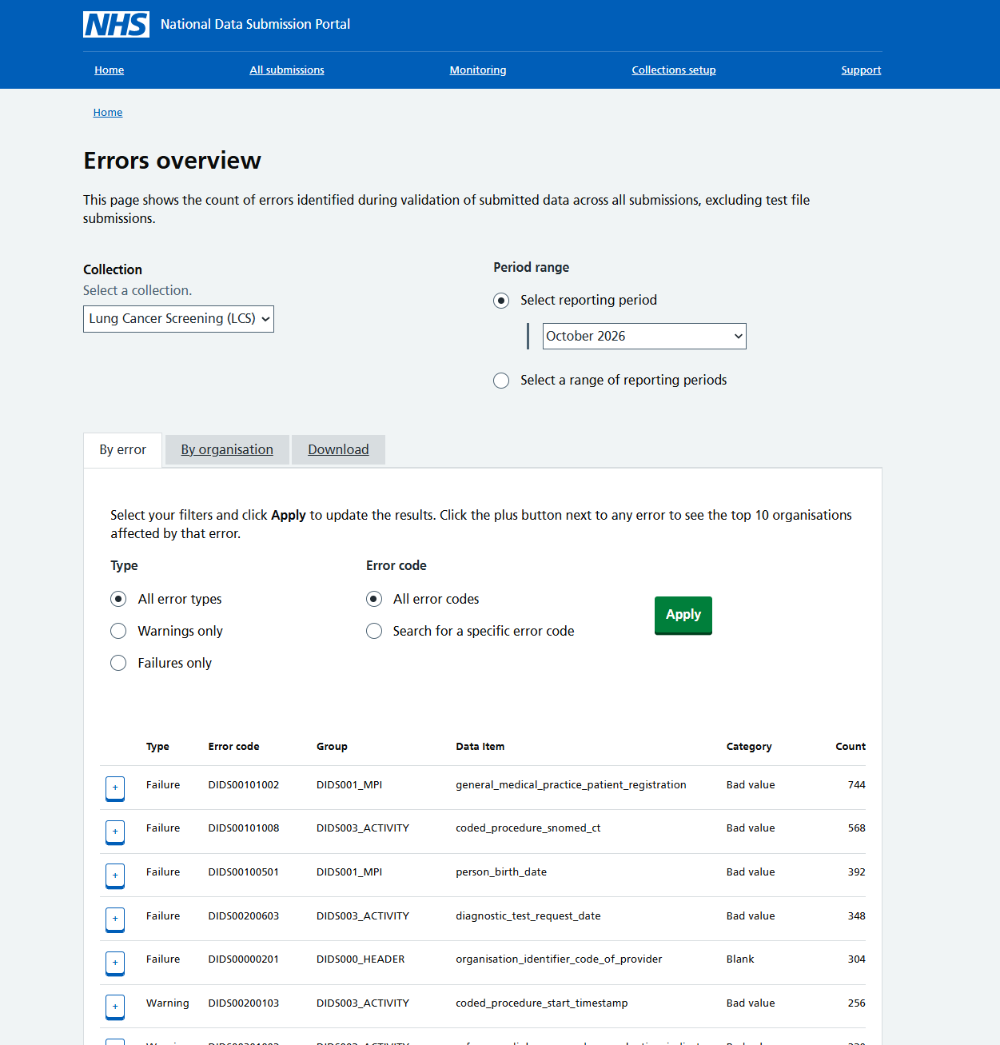
Errors overview
Within your Cancer Alliance – view which errors are most common across all organisations. You can view for a particular reporting period, or by a range of reporting periods.
Expanding the ‘+’ box will give you a view of which organisations are having problems.

Slide 19
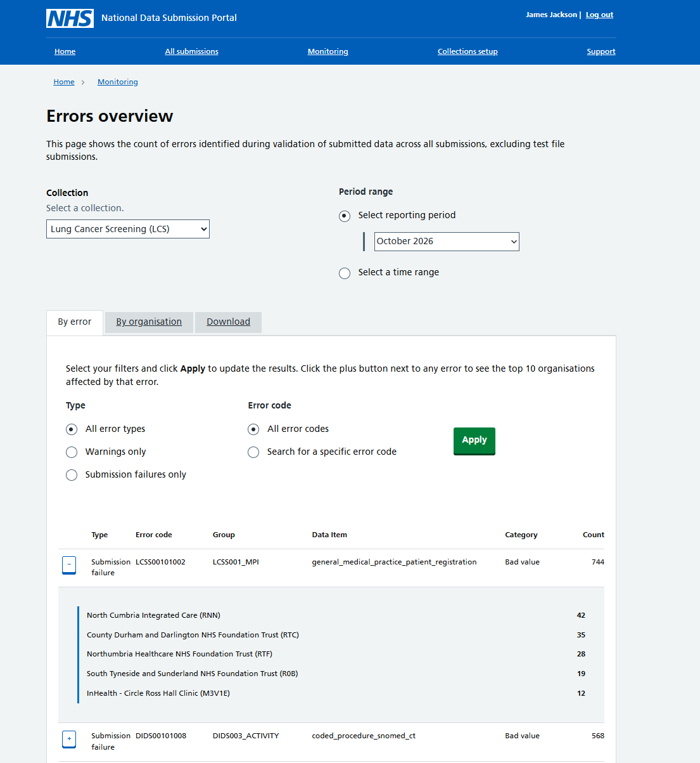
Which organisations are having difficulties with a particular data item?
View a list of how often the error has occurred for organisations in your area.

Slide 20
What’s happening next with submission monitoring?
We’ve just completed some usability testing with internal NHS England monitoring staff who will also use these tools – we’re making some changes to the layout and designs based on their feedback.
We’re developing guidance and training materials about how to use the monitoring tools.
If you are going to be using the monitoring tools:
- You will need a CIS2 account to access the system. Some of you may already have them but we will share guidance on how to request one.
- Nearer to go live, we will be in touch to request contact details for the CA team members you would like to have monitoring permissions.
Notes:
Suggest 2- 3 people per CA

Slide 21
Q&A

Slide 22
Monthly dashboard – to summarise quality

Slide 23
Hello!
Cross-disciplinary user centred designer/researcher
Wide ranging design and research experience
Insight-driven innovation, early stage product development
2 years in the NHS: Breast Screening reporting
Experience working with FDP
X
Yes but no...

Slide 24
Approach
I wear a few 'hats' to speed things up: research, prototyping, design lead
Preparing the ground for the data team
Find out what to build that meets needs
Design for efficient build

Slide 25
Approach
Designed with your input, like NDSP
Iterative process
(more than one version)
Test it with you to make sure we got it right
Your needs
Programme needs
What we can do with the data we have

Slide 26
Reducing barriers to access
User research revealed barriers to accessing data in different systems
expiring logins between uses
Complex multi-step or and obscure processes were offputting
Lost logins caused issues
Not hearing back when requesting access
In busy environments users give up – or get someone to print it!
We can pre-register you on NHS Apps which cuts out a big step…

Slide 27
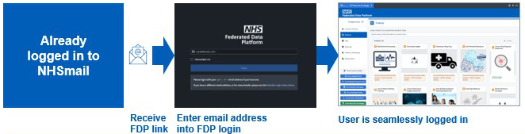
nhs.net email
If you give us your email address in advance it will be this simple.

Slide 28
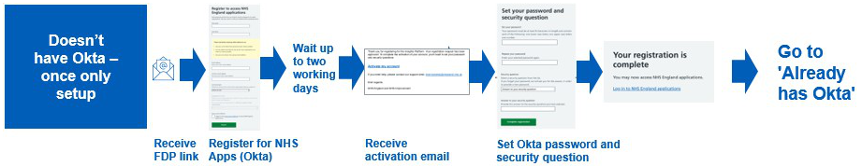
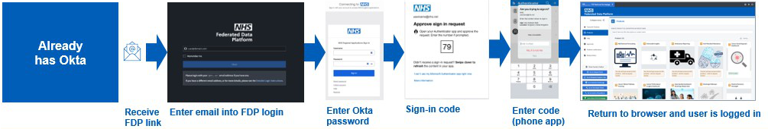
nhs.uk and others
1. Register with NHS apps (Okta system) and create password once only
2. Then it’s pretty simple…

Slide 29
Monthly data quality monitoring
How it differs from what you see in NDSP
NDSP will submit all 'last best files' once a month
This is what we'll use for a retrospective monthly data quality overview
National view, Alliance view and Service Provider views
Like NDSP, Alliances won’t be able to see a detailed provider level view of each other’s data (RBACS); nor will providers
Governance, access and readiness
Data development and derivations
Data quality, rules and assurance
National dashboard development
Data linkage
Cancer Alliance record level access

Slide 30
Monthly data quality monitoring
What it’s for
Summary not a detailed working level
Enable comparison between NECS and NDSP so that differences between totals can be investigated
Showing where there might be gaps
Help drive up completeness of the data
The better quality the data from all providers, the better quality and depth of insight we’ll be able to offer down the track
Governance, access and readiness
Data development and derivations
Data quality, rules and assurance
National dashboard development
Data linkage
Cancer Alliance record level access

Slide 31
Monthly data quality monitoring
We need to learn…
Your priorities and needs
Whether we can bring other data sources together
(NDSP warnings / NECS aggregates)
What we can determine from the submitted data to help you see where improvements can be made
Go-live plan: January 2027
Governance, access and readiness
Data development and derivations
Data quality, rules and assurance
National dashboard development
Data linkage
Cancer Alliance record level access

Slide 32
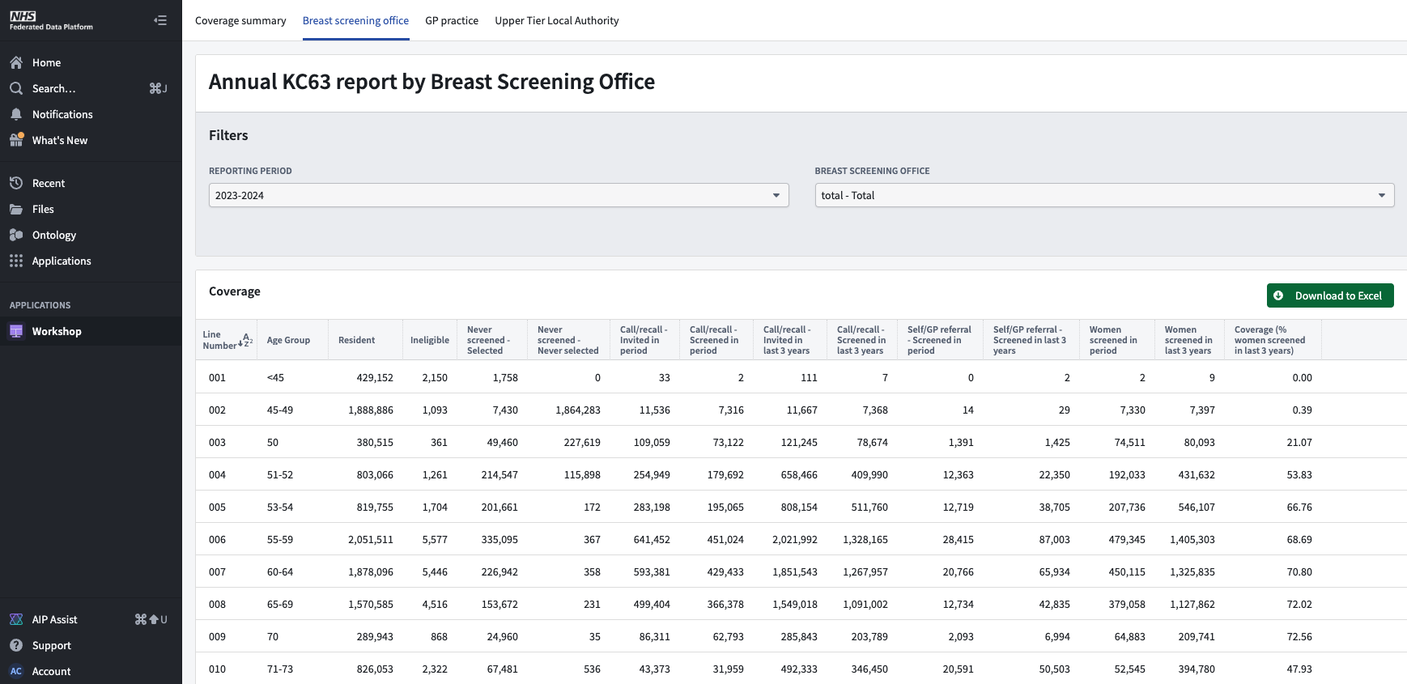
Here’s one we made earlier…
'like for like' recreation of existing product

Slide 33
Here’s a prototype…
Not built yet
Several iterations later
Meets more needs
Offers insight, not just numbers
DPIA must cover it

Slide 34
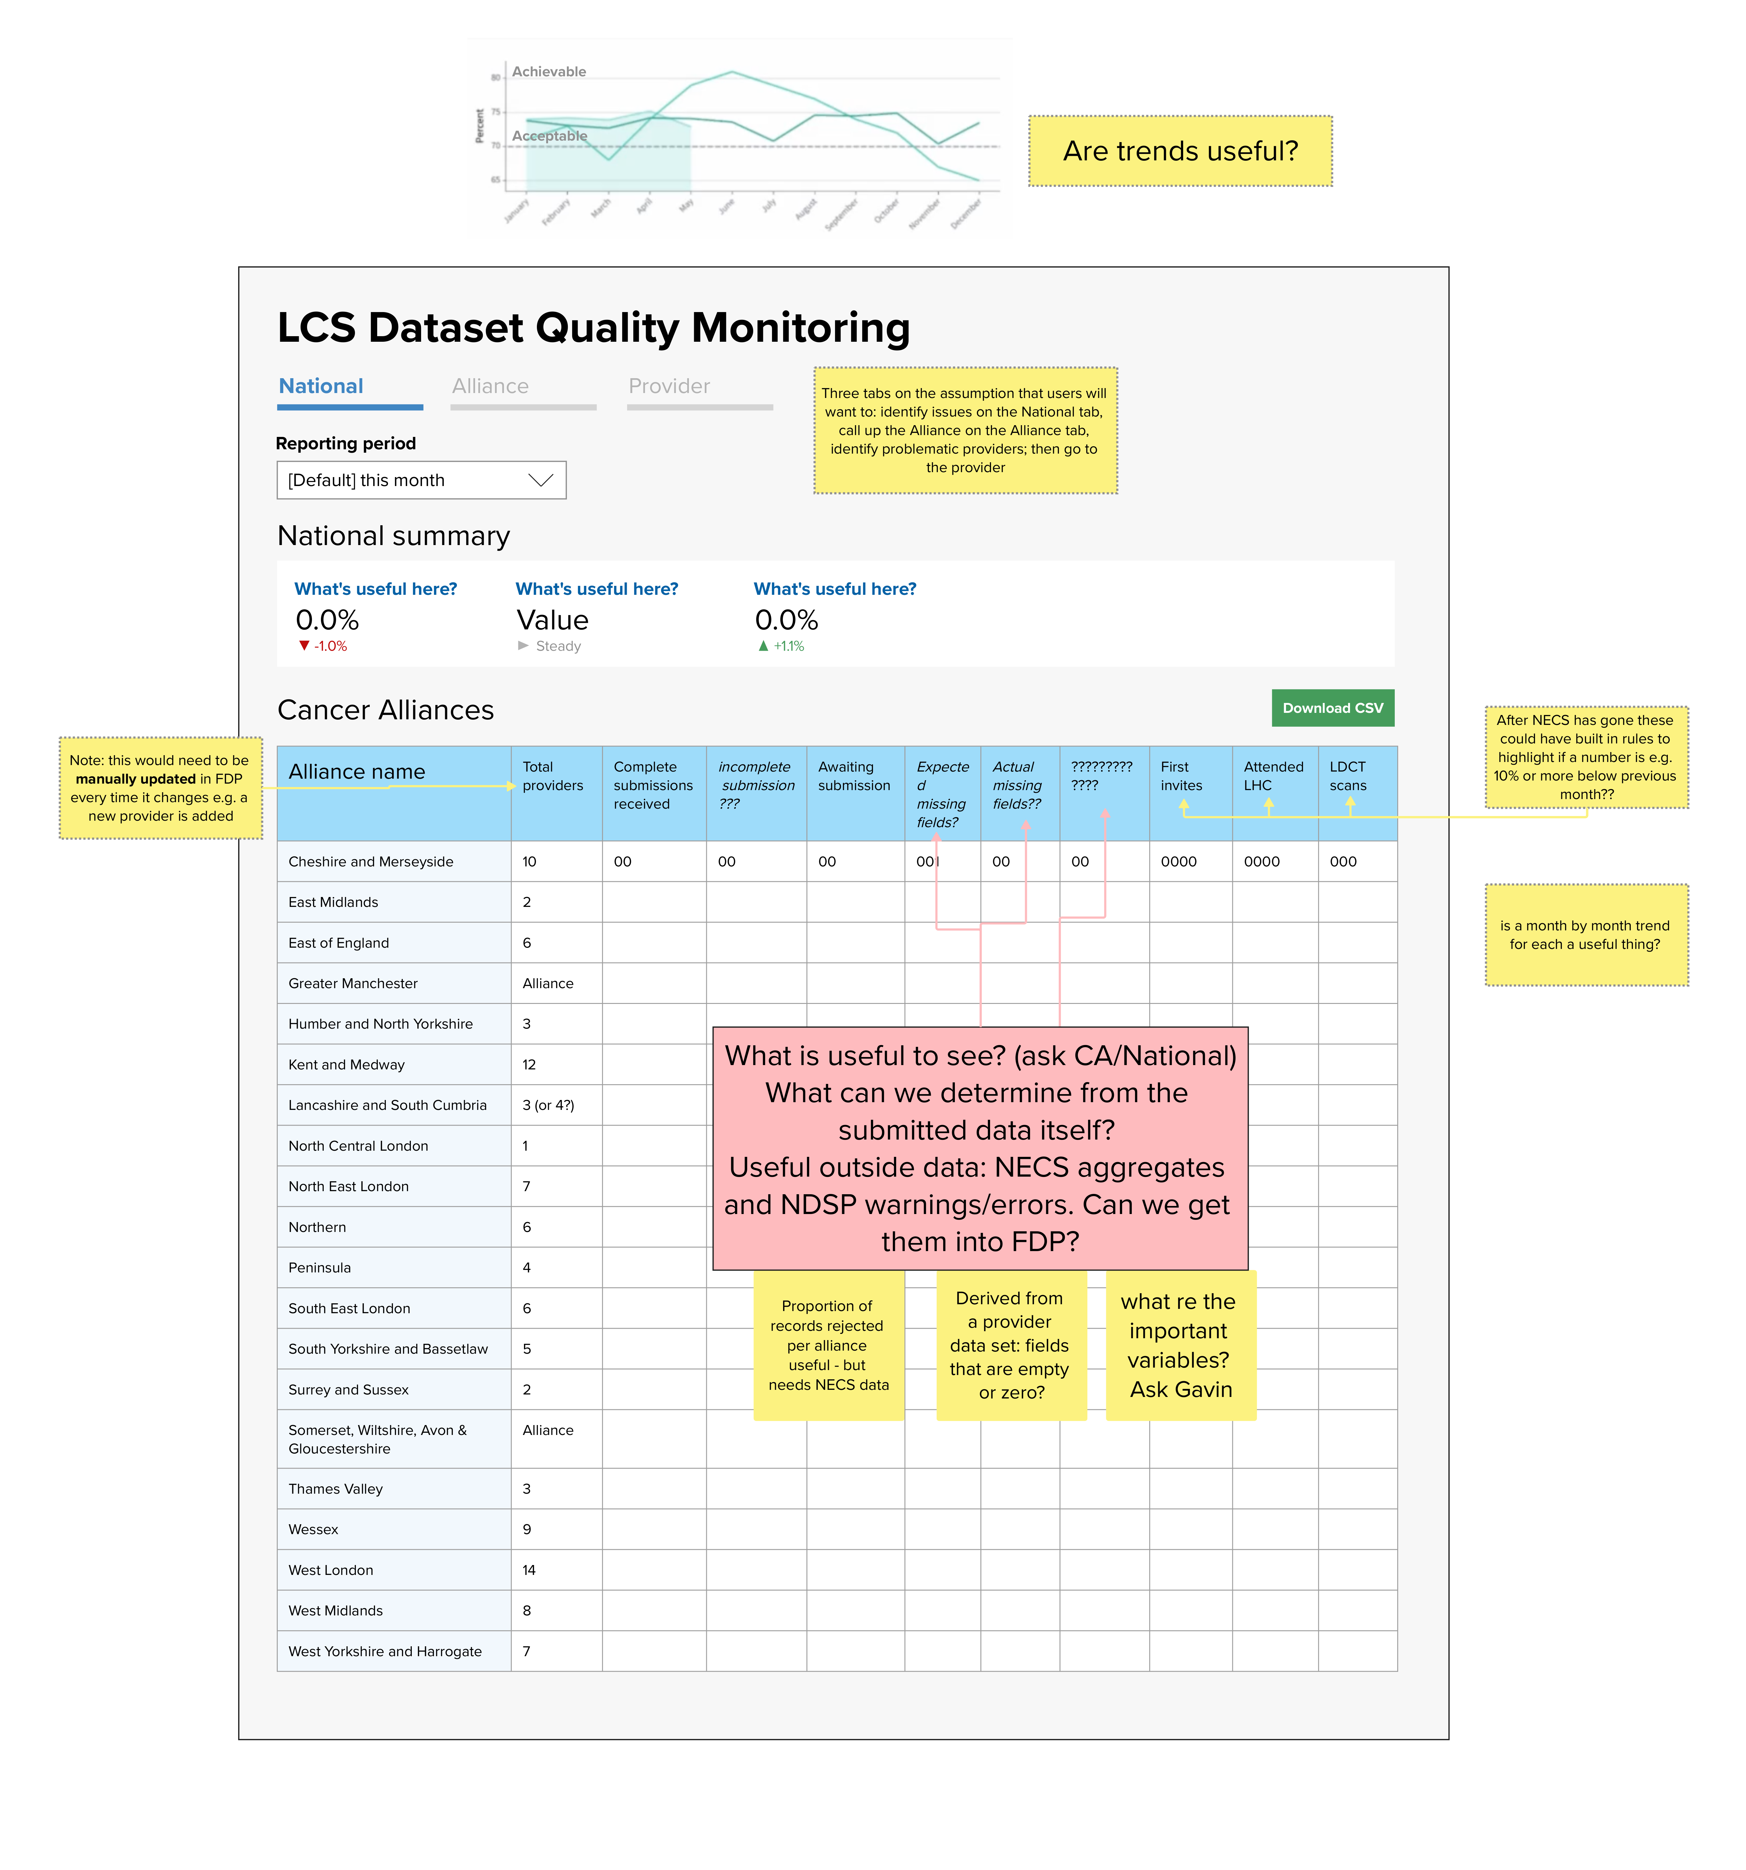
Over to you…
I started having a look but I need to hear from you
In the chat ...
what are the top three things you’d like to be able to understand from a monthly data quality dashboard?
What questions do you want it to give you the answers to?

Slide 35
If you’d like to get more involved…
Please post the word “research” in the chat
Expect to hear from me in the next few weeks
Plus wider call for those who missed today

Slide 36
Next steps
IG Q&A drop-in session – in next couple of weeks
Email to Cancer Alliance Leads outlining guidance on ODS codes and CIS2 accounts
Wider drop-in sessions across various topics
Any other requests for support or sessions?

Slide 37
Q&A

Slide 38
Who to contact?
Data set related queries:
Dataset.Development@nhs.net.
Policy or general programme questions:
england.lungcancerscreening@nhs.net
Data Liaison Support:
england.dataliaison@nhs.net

